Slide 1
HeapFile
Manager
CS564: Assignment 5

Slide 2
FAQs
Return arguments in C
const Status getStudent(const int studentId, Student& studentOutput)
Page Number in files
Not sequential. More like identifiers or pointers
Record vs row Typically, a row will form a record. But not always
HeapFile object vs heap file on disk
HeapFile is a class whose objects programmatically represent heap files on disk

Slide 3
Overview
3. Buffer Manager | 4. HeapFile Manager
5. Front-End and Database Utilities | 6. Query and Update Operators

Slide 4
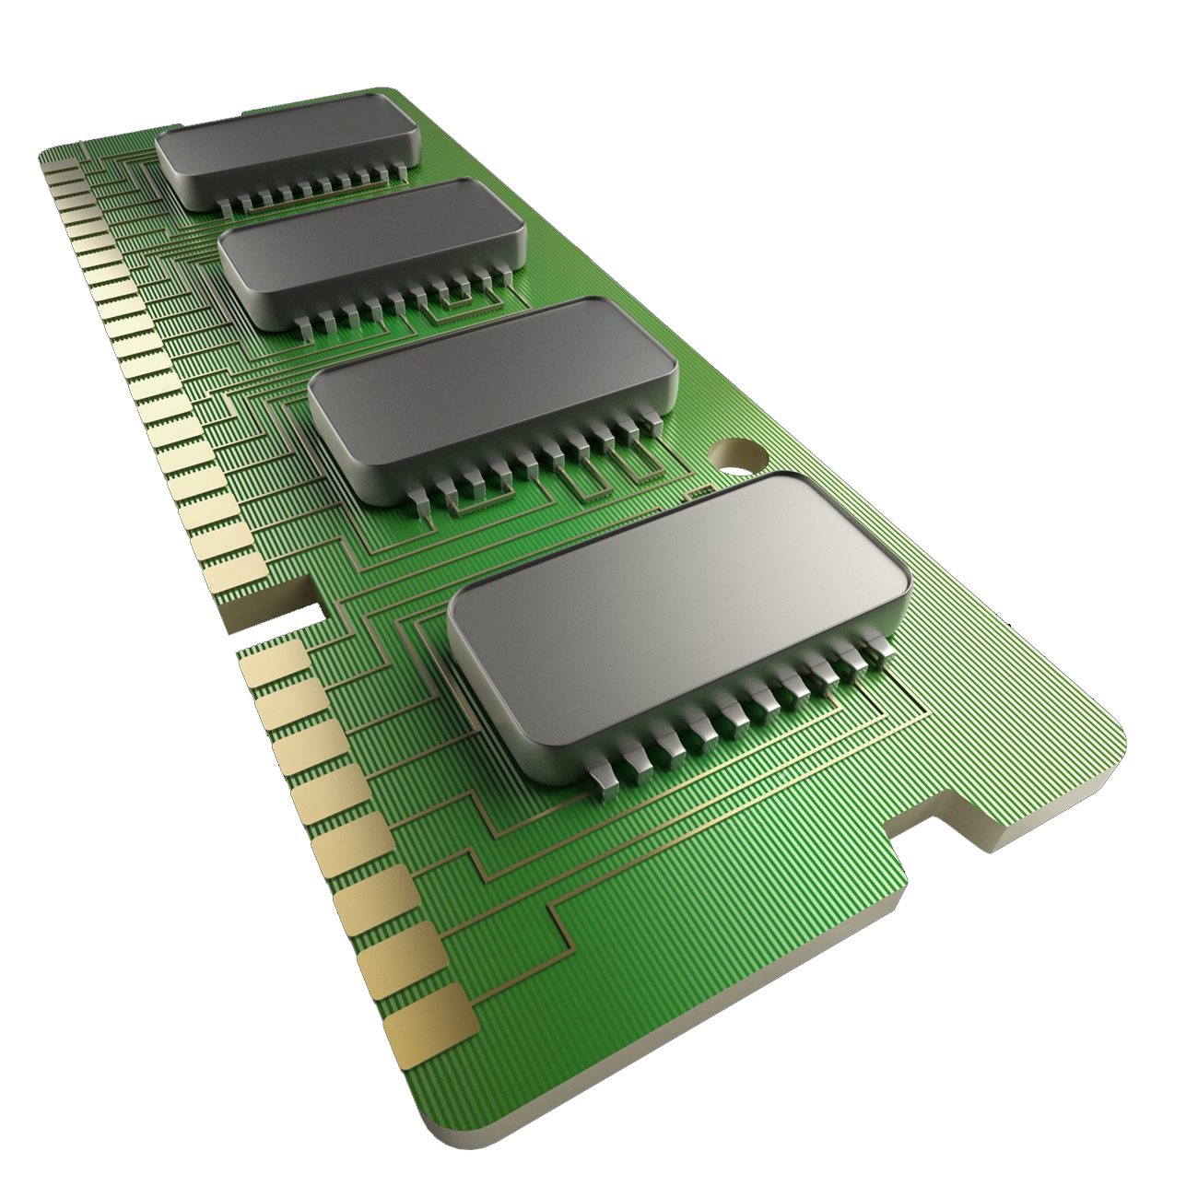
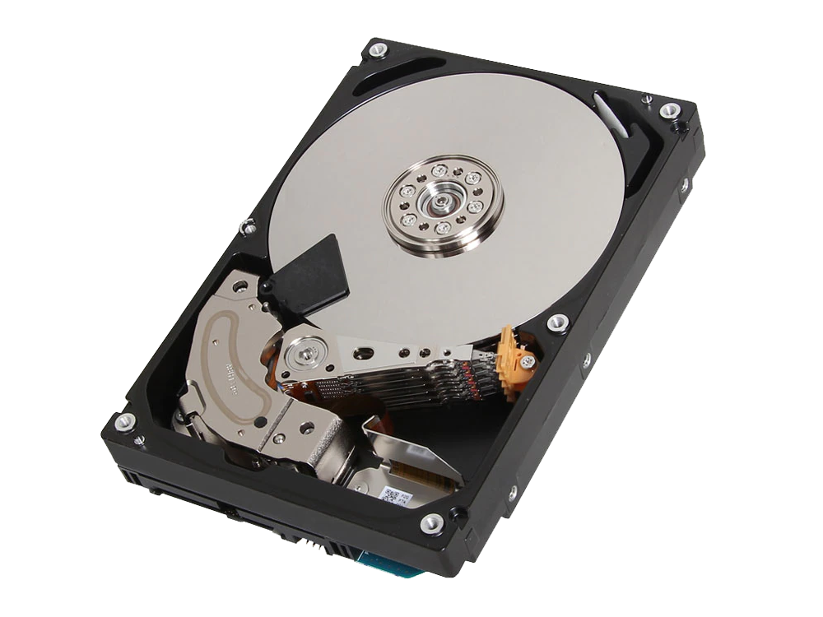
Buffers & Frames
RAM
DISK
DB

Slide 5
Buffers & Frames
RAM
DISK
BUFFER POOL
DB
4KB
4KB
FRAME 1
FRAME 2
…
FRAME N
4KB
…

Slide 6
Buffers & Frames
RAM
DISK
BUFFER POOL
DB
4KB
4KB
4KB
4KB
FRAME 1
FRAME 2
…
FRAME N
4KB
…
Notes:
Read + write on pages in buffer pool

Slide 7
How data is arranged
Albert Einstein | 1879 | Physics
Marie Curie | 1876 | Chemistry
Charles Darwin | 1890 | Biology
Galileo Galilei | 1564 | Astronomy
Stephen Hawking | 1942 | Physics
Nikola Tesla | 1876 | Physics
James Watson | 1928 | Genetics
Ada Lovelace | 1907 | Computers
Rachel Carson | 1928 | Physics
Richard Feynman | 1918 | Physics
Notes:
Programmer or user’s view of the DB.

Slide 8
How data is arranged
File
Albert Einstein | 1879 | Physics
Marie Curie | 1876 | Chemistry
Charles Darwin | 1890 | Biology
Galileo Galilei | 1564 | Astronomy
Stephen Hawking | 1942 | Physics
Nikola Tesla | 1876 | Physics
James Watson | 1928 | Genetics
Ada Lovelace | 1907 | Computers
Rachel Carson | 1928 | Physics
Richard Feynman | 1918 | Physics
Page 1
Page 2
Page 3

Slide 9
How data is arranged
File
Albert Einstein | 1879 | Physics
Marie Curie | 1876 | Chemistry
Charles Darwin | 1890 | Biology
Galileo Galilei | 1564 | Astronomy
Stephen Hawking | 1942 | Physics
Nikola Tesla | 1876 | Physics
James Watson | 1928 | Genetics
Ada Lovelace | 1907 | Computers
Rachel Carson | 1928 | Physics
Richard Feynman | 1918 | Physics
Page 1
Page 2
Page 3

Slide 10
Record ID (RID):
(Page Number, Slot Number)
Slot 1
Record 1
Slot 2
Record 2
Slot 3
Prev Page
Next Page
Slot 4
Slotted Page

Slide 11
Heapfiles (unrelated to Heap data structure)
Unordered set of records
Heap files can be created and destroyed
Existing heapfiles can be opened and closed
Records and pages can be inserted and deleted
Records are uniquely identified by a record id (RID)
First page is a special Header-Page
Notes:
Page numbers are IDs of pages but they are not necessarily sequential

Slide 12
Why HeapFiles?
Simplicity
Fast Inserts
Space Efficiency
Alternatives: Sorted files, B-Trees, Hash Indexes, …
Notes:
Page numbers are IDs of pages but they are not necessarily sequential

Slide 13
Programmatic Representation
Notes:
Heapfile on disk vs heapfile object

Slide 14
HeapFile
File* filePtr | FileHdrPage* headerPage
int headerPageNo | Bool hdrDirtyFlag
char fileName
int firstPage
int lastPage
int pageCnt
int recCnt
Page* currPage
Record 1 | Record 2
int curPageNo | Bool curDirtyFlag
RID curRec (page #, slot #)
FileHdrPage

Slide 15
File* filePtr | FileHdrPage* headerPage
int headerPageNo | Bool hdrDirtyFlag
Page* currPage
Prev Page
Next Page
curPageNo = blue | curDirtyFlag
RID curRec (page #, slot #)

Slide 16
File* filePtr | FileHdrPage* headerPage
int headerPageNo | Bool hdrDirtyFlag
Page* currPage
Prev Page
Next Page
curPageNo = green | Bool curDirtyFlag
RID curRec (page #, slot #)

Slide 17
File* filePtr | FileHdrPage* headerPage
int headerPageNo | Bool hdrDirtyFlag
Page* currPage
Prev Page
Next Page
curPageNo = green | Bool curDirtyFlag
RID curRec (page #, slot #)

Slide 18
File* filePtr | FileHdrPage* headerPage
int headerPageNo | Bool hdrDirtyFlag
Page* currPage
1
2
3
4
Prev Page
Next Page
curPageNo = green | Bool curDirtyFlag
RID curRec (page: green, slot: 2)

Slide 19
File* filePtr | FileHdrPage* headerPage
int headerPageNo | Bool hdrDirtyFlag
Page* currPage
1
2
3
4
Prev Page
Next Page
curPageNo = green | Bool curDirtyFlag
RID curRec (page: green, slot: 3)

Slide 20
File* filePtr | FileHdrPage* headerPage
int headerPageNo | Bool hdrDirtyFlag
Page* currPage
1
2
3
4
Prev Page
Next Page
curPageNo = green | Bool curDirtyFlag
RID curRec (page: green, slot: 4)

Slide 21
File* filePtr | FileHdrPage* headerPage
int headerPageNo | Bool hdrDirtyFlag
Page* currPage
1
2
3
4
Prev Page
Next Page
curPageNo = orange | Bool curDirtyFlag
RID curRec (page: orange, slot: 1)

Slide 22
Creating a heap file (just the file, not the Class object)
const Status createHeapFile(const string fileName)
Check fileName not exists
Create file db.createFile(fileName) and open
Allocate a header page using bufMgr->allocPage
FileHdrPage* hdrPage = (FileHdrPage *) newPage;
Allocate an empty, data page and call newPage->init(newPageNo);
Unpin pages
Flush and close file

Slide 23
HeapFile
File* filePtr | FileHdrPage* headerPage
int headerPageNo | Bool hdrDirtyFlag
char fileName
int firstPage
int lastPage
int pageCnt
int recCnt
Page* currPage
Record 1 | Record 2
int curPageNo | Bool curDirtyFlag
RID curRec (page #, slot #)
FileHdrPage
Notes:
While we are on the topic of this header page, what exactly is its purpose?

Slide 24
Creating a heap file
createHeapFile(“famous_chemists”)
famous_chemists
filename
firstPage
lastPage
pageCnt
recCnt
HdrPage
Data Page

Slide 25
Constructing a HeapFile object (from a heap file on disk)
HeapFile::HeapFile(const string & fileName, Status& returnStatus)
Check fileName exists and open
Assign the header-page with filePtr->getFirstPage and bufMgr->readPage
headerPage = (FileHdrPage *) pagePtr;
Read the first data page into curPage and curPageNo
curRec = NULLRID;

Slide 26
HeapFile
File* filePtr | FileHdrPage* headerPage
int headerPageNo | Bool hdrDirtyFlag
char fileName
int firstPage
int lastPage
int pageCnt
int recCnt
Page* currPage
Record 1 | Record 2
int curPageNo | Bool curDirtyFlag
RID curRec (page #, slot #)
FileHdrPage

Slide 27
Get a Record (by RID)
const Status HeapFile::getRecord(const RID & rid, Record & rec)
If on correct page: curPageNo == rid.pageNo:
Call getRecord on current page (gets record by slot number)
Update HeapFile object
Done!
Unpin current
Update HeapFile object
curPageNo,
curDirtyFlag
curRec
Read page using curPageNo, then call getRecord

Slide 28
Scan Next
const Status HeapFileScan::scanNext(RID& outRid)
Purpose:
SELECT * FROM famous_chemists WHERE alias = “Heisenberg”
“filter” in HeapFile set using startScan.
Name | Alias | Address | Affiliation | DOB
Walter White | Heisenberg | Albuquerque | Los Pollos | Sept 7, 1958

Slide 29
Scan Next
const Status HeapFileScan::scanNext(RID& outRid)
Valid current Page
Iterate over pages and records (use nextPage and nextRecord)
if (matchRec(rec)) return curRec as outRid
If reached end of file, return EOF
Before moving to next page, do cleanup
Unpin previous page
Update all relevant HeapFile object fields
Start from first record of new page (curPage->firstRecord)

Slide 30
Scan Next
const Status HeapFileScan::scanNext(RID& outRid)
Invalid current Page
Start from first page (headerPage->firstPage)
Start from first record (curPage->girstRecord)
Do steps from previous slide

Slide 31
Insert a Record
const Status InsertFileScan::insertRecord(const Record & rec, RID& outRid)
Valid current Page
Call insertRecord on curPage
If OK, update header page fields and update curRec
Else, no-space - insert in a new page at the end
Allocate new page and initialize it
Unpin current page and update to new page
Call insertRecord on this new Page
Update header page fields

Slide 32
Insert a Record
const Status InsertFileScan::insertRecord(const Record & rec, RID& outRid)
Invalid current Page
Read the last page (Use hdrPage->lastPage)
Set last page as current page
Do step s from previous slide

